Slide 1
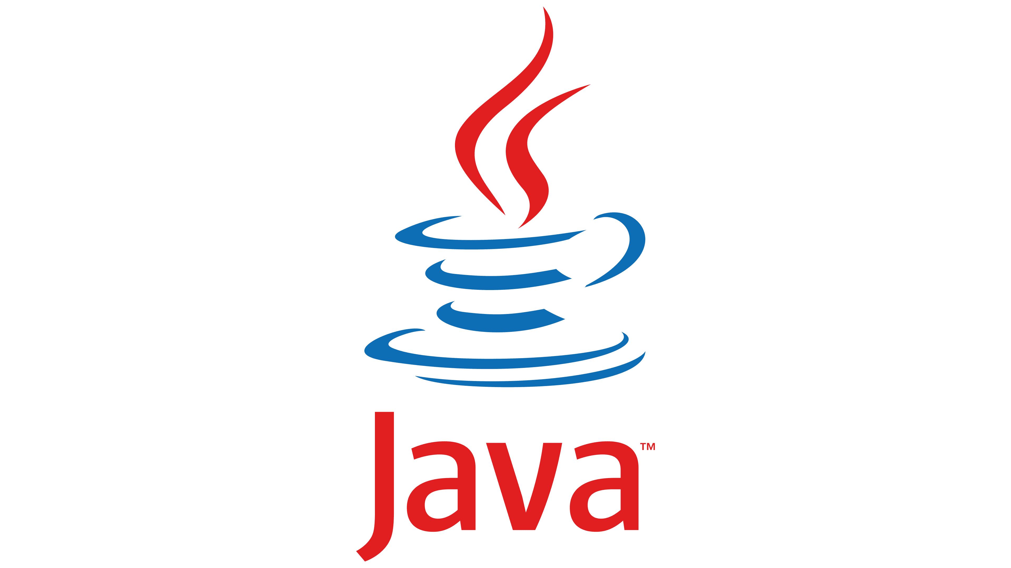
OBJECT ORIENTED PROGRAMMING
&
IT’S PRINCIPLES.
Team Leader:
Aveshek Rajbanshi.
Team Members:
1

Slide 2


Introduction to JAVA
History of JAVA
JAVA is a general purpose, high-level Object Oriented Programming Language. In Other words,
the way of thinking is java.
JAVA was Invented by James Gosling
in 1995 A.D while he was working at
Sun Microsystems. Hence, James Gosling
is also known as father of java.
What is the JAVA
Programming language used for ?
JAVA creator team also known as Green Team.
There names are James Gosling, Patrick Naughton, Chris Warth, ED Frank and Mike Sheridan. James Gosling & his team called their project as “GreenTalk” & it’s file extension was .gt.
JAVA is an extremely transferable programming language used across platforms & different types of devices from smart phones, smart TV to Desktop.
Why use JAVA ?
It is one of the most popular language in the world.
Java works on different platforms ( Windows, Mac, Linux ) & others.
2

Slide 3
PRINCIPLES
Object Oriented Programming
01
CLASS & OBJECTS
02
INHERITANCE
OOP Principle is the most widely used programming paradigm that assist in developing large-scale application in the real World by using this concepts that allows multiple developers to work together with such that, it can make the complete system.
03
ABSTRACTION
04
ENCAPSULATIONS
05
POLYMORPHISM
3

Slide 4
JAVA FEATURES /
BUZZ WORDS
Simple
Dynamic
Object
Oriented
Distributed
Portable
Java is the most popular Object Oriented Programming Language. Java has many advanced features, a list of key features is known as Java Buzz Words.
The Java team has listed the following terms as Java Buzz Words.
Multi-
Threaded
Platform-
Independent
FEATURES
OF
JAVA
High-
Performance
Secured
Interpreted
Robust
Architecture
Neutral
4

Slide 5
z
01
What is OOP ? It’s Benefits/Advantages.
02
Know The Differences Between
OOP and POP
Object – Oriented Programming
Procedural Oriented Programming
DATA
DATA
GLOBAL DATA
GLOBAL DATA
FUNCTIONS
FUNCTIONS
DATA
FUNCTION 1
FUNCTION 1
FUNCTION 1
FUNCTIONS
LOCAL DATA
LOCAL DATA
LOCAL DATA
5

Slide 6
#1
What is JVM ??
#1.1
How JVM works & place in execution of a program in java ?
‘JVM’ refers to Java Virtual Machine.
JVM is not an actual machine but the run
time system for java.
In most cases, Other programming languages,
the compiler Produce code for a particular
Operating System but the Java compiler produces
BYTECODE only for a Java Virtual Machine.
Java Source Code
( .Java Extension )
Javac
( Compiler )
JVM
Mac
JVM performs the following main tasks:
Load Code.
Reading Bytecode.
Verifies Code.
Providing Runtime Environment etc.
Java Byte Code
( .Class Extension )
JVM
Windows
JAVA VIRTUAL MACHINE ( JVM )
JVM
Linux
BYTECODE
?
Output
6

Slide 7
# 01
What is BYTECODE ?
When java compiles a code then it converts the program into the special architectural neutral executable program called Bytecode.
Java source code is compiled into Bytecode by java compiler & Bytecode will be stored in class files. During runtime, this Bytecode will be loaded, verified & JVM interprets the Bytecode into machine code which will be executed in the machine in which the java program run.
# 02
What is JRE ?
JRE
‘JRE’ refers to Java RunTime Environment. It’s is a set of components to create & run a java application.
A JRE is made up of a JVM, java class libraries & java class loader. It is used to provide the runtime environment.
Class Loader
&
Bytecode Verification
Java Class Libraries
AWT, net, i/o etc.
JVM
> Java Interpreter
> Garbage Collection
> Threading etc.
Fig: A layered architectural view shows that the JRE contains the JVM.
7

Slide 8
# 03
What is JDK ?
‘JDK’ stands for Java Development Kit.
Jdk contains the JRE with compiler, interpreter, debugger & other tools. It Provides features to run as well as develop java program.
It’s a software development environment used for developing java application and applets.
Java Source Code
Java Run Time Environment
(JRE)
Java Development Kit.
JAVA
Compiler
Java Byte
Code
Just-In-Time Compiler
(JIT)
Java Virtual Machine
(JVM)
Hardware Platform
Fig: Interaction Between JDK & JRE.
8

Slide 9
How to Install / Download JDK ?
Case: Install Jdk of Java File.
Step 1: Turn your pc or desktop on, connect to internet and open Browser. Search https://downloadjdkofjava. Download jdk file according to the Operating
System of your devices i.e. Windows, Mac, Linux etc.
Case: Location of Jdk File & it’s Sub-file.
Step 2: Refresh your screen & click; This PC > Local Disk (c:) drive > Program files > Java folder > Jdk-20 > bin file > java.exe & javac.exe application and
software are present.
Case: To Check Java Version.
Step 3: Click (window + R) and type (cmd) command prompt window open. Similarly, type: java –-version. After enter it will show current java
version installation date/year.
Case: To Check Javac Compiler.
Step 4: Click (window + R) and type (cmd) command prompt window appear. Similarly, type: javac and enter after that it will show compiler details.
Case: To Create a Short Java Program.
Step 5: Create new folder, open notepad & write Syntax or Structure of java program. Save the file in new created folder with file extension .java. Open
that created file in command prompt window & type : javac filename.java
: java filename
After, enter it will show information you coded in the java program.
9

Slide 10
Let’s Know the Simple Program of Java.
public class Leader
{
()
public void teamLeader
{
String name = “Aveshek Rajbanshi.”;
String nature = “Friendly”;
String quality = “Leader leads his/her team.”;
Int id = 101;
System.out.println (quality);
}
{
public static void main(String[] args)
();
Leader lead = new Leader
Lead. teamLeader
();
}
}
Output:
Leader leads his/her team.
10

